Slide 1
Project
Loan Eligibility prediction using machine learning
Aditya Varma

Slide 2
Introduction
Project: Loan Eligibility Prediction
Goal: Predict whether a loan will be approved based on applicant data.
Tools Used: Python, Pandas, NumPy, Matplotlib, Scikit-learn, Jupyter Notebook

Slide 3
Dataset Overview
Source: train.csv
Records: 614 entries
Features: Gender, Marital Status, Dependents, Education, Self Employed, Income, Loan details, Credit History, Property Area
Target: Loan Status (Y/N)

Slide 4
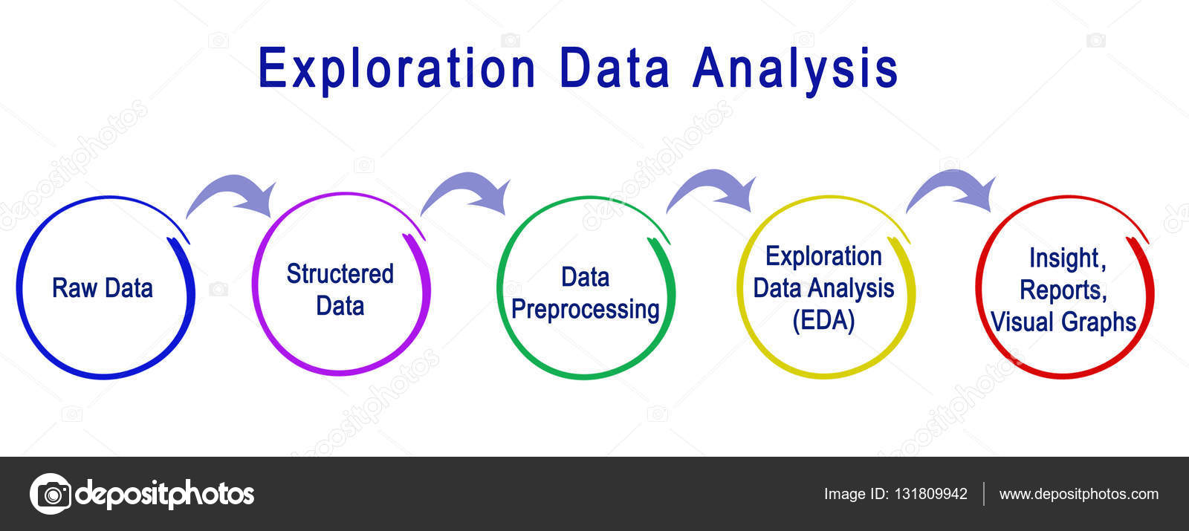
Data Exploration
Used head(), shape, info() for basic insights
Summary statistics via describe()
Insights:
Applicant income ranges from 150 to 81,000
Loan amounts vary significantly
Credit history seems crucial

Slide 5

Missing Values Analysis
Missing in Gender, Married, Dependents, Self Employed, Loan Amount, Loan_Amount_Term, Credit History
Strategy:
Mode imputation for categorical features
Mean/Median imputation for numerical

Slide 6
Data Cleaning & Feature Engineering
Filled missing values appropriately
Added Loan Amount log and Total Income (with log transformation)
Created final feature set X and label y

Slide 7
Data Visualization
Histograms: Applicant Income, Loan Amount, Total Income
Boxplots to detect outliers
Cross-tab: Credit History vs Loan Status

Slide 8
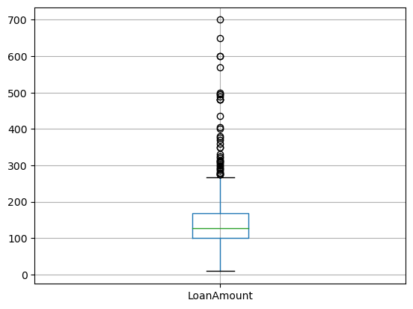
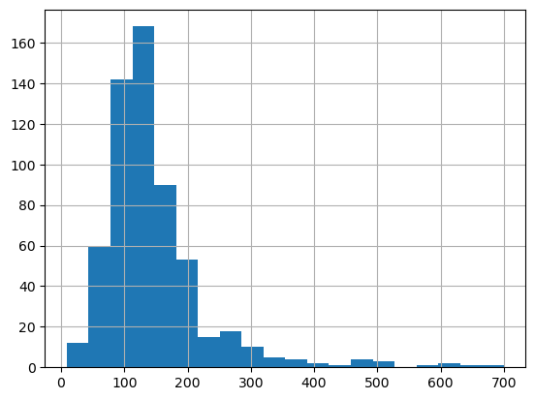
Histogram for income distribution

Slide 9
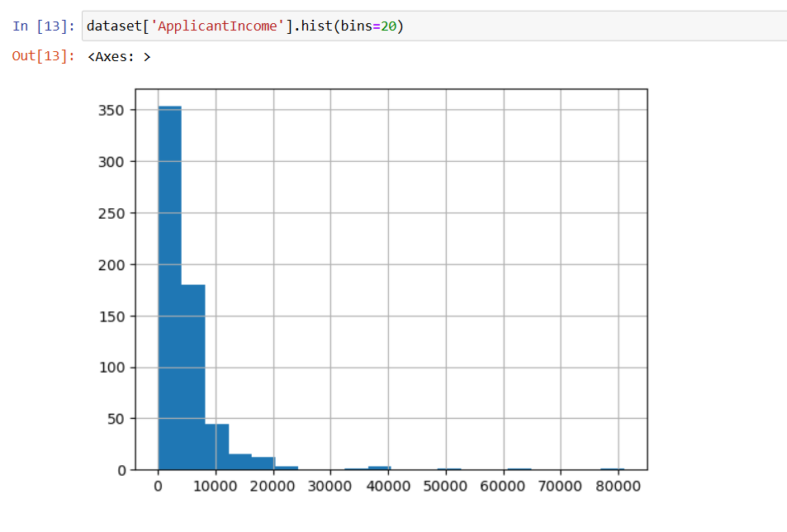

Slide 10
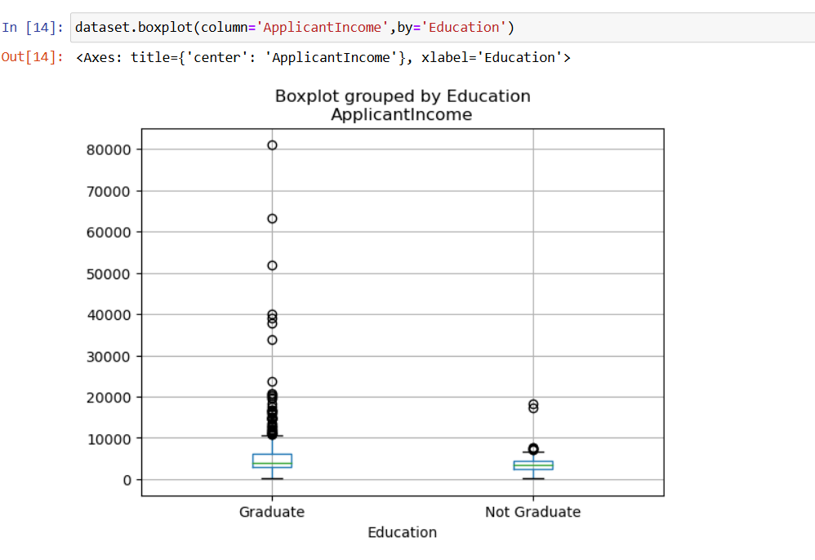

Slide 11
Data Preprocessing
Label Encoding for categorical features
Feature Scaling using Standard Scaler
Split into train and test sets (80/20)

Slide 12
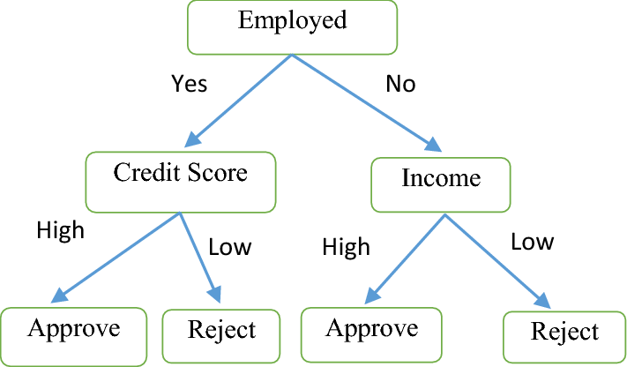
Decision Tree
Algorithm: Decision Tree Classifier with entropy criterion
Accuracy: ~70.7%
Pros: Easy to interpret
Cons: Prone to overfitting

Slide 13
Model 2 - Naive Bayes
Algorithm: Gaussian NB
Accuracy: ~82.9%
Pros: Fast, works well with categorical features
Cons: Assumes feature independence

Slide 14
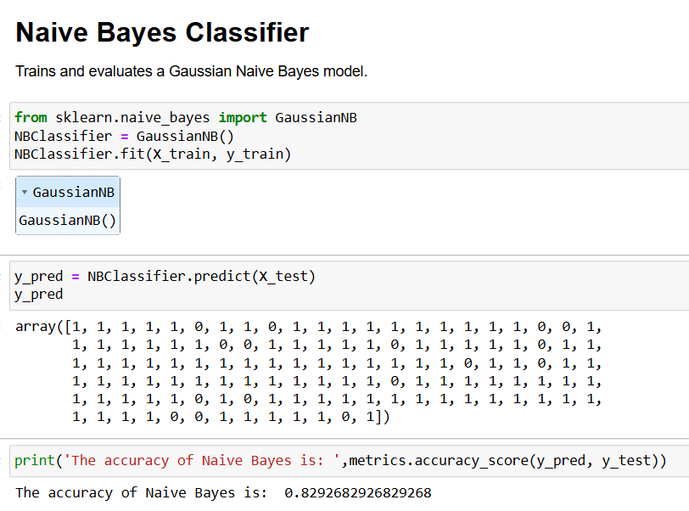

Slide 15
Prediction on New Data
Loaded train.csv as test
Filled missing values
Engineered features
Applied Naive Bayes model for predictions

Slide 16
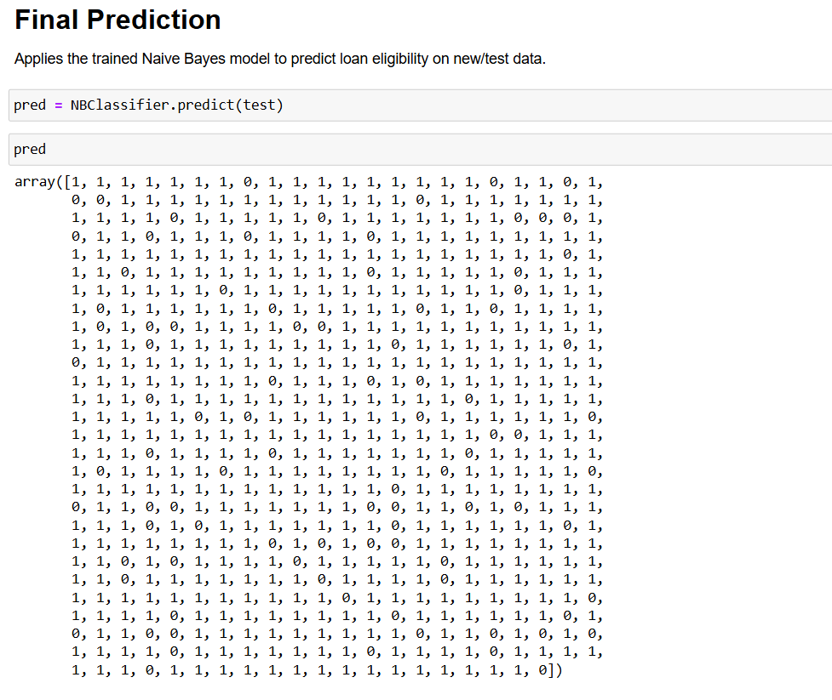

Slide 17
Conclusion
Credit History is a key determinant
Naive Bayes gave the highest accuracy among tested models
Further improvement: Try Logistic Regression, Random Forest, hyperparameter tuning

